Slide 1
PBC Coach Support

Slide 2
Welcome
Introductions/Icebreaker
Agenda review
Norm Discussion
Logistics of accessing Shared Resources (Share point, Google Drive, One Drive, etc)
PM Content: Implementation Guides
Coaching Sessions: 1, 2, and 3
First Teacher Session
Notes:
Welcome, Celebrations, Check in

Slide 3
Agenda
Introductions/Icebreaker
Agenda review
Norms
Logistics/Housekeeping
Coaching Focus
PM Content Focus
Just In Time Support: Questions and Brainstorming
Next Steps
Notes:
Welcome, Celebrations, Check in

Slide 4
Norms

Slide 5
Logistics - Housekeeping
Using Box
Study Updates

Slide 6

Coaching Focus
ADD images, materials here

Slide 7
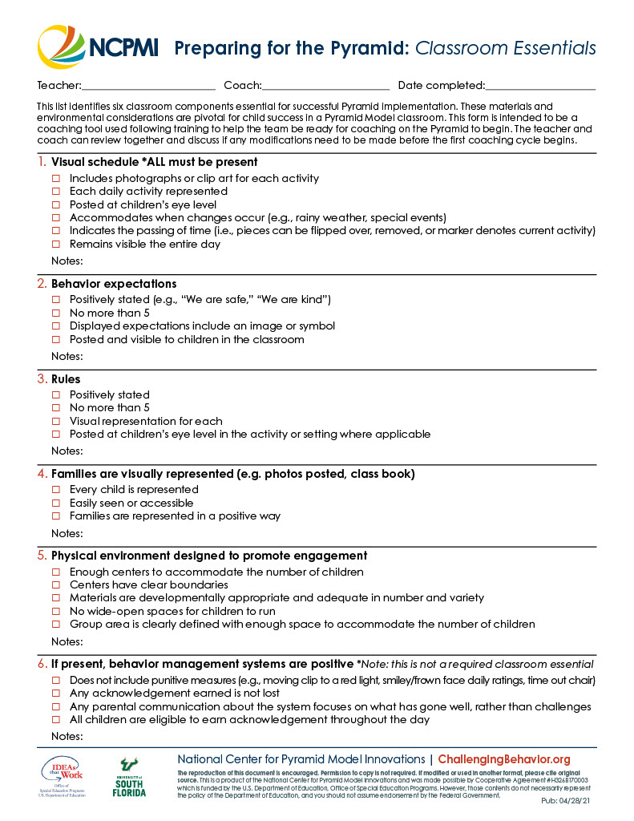
Pyramid Model Content Focus

Slide 8
Just in Time Support: Questions and Brainstorming

Slide 9
Resources
ADD Links to resources on NCPMI website and in folder for Coach Support Resources.
Chapters

Slide 10
Next Steps
Next Steps for Coaches:
Review..
Practice..
Complete..
Next Meeting Date and Time:

