Slide 1
Conducting a Buy-In Presentation
Staff meeting to explain the Pyramid Model
Goal is to share information and get all program staff on board
Buy-in poll is conducted at end, seeking 80% agreement that doing this work is a good idea for the program
To listen to Lise Fox of NCPMI explain the staff buy-in process and how to use the slide deck click on this link:
https://youtu.be/DPipdc7uPvE

Slide 2
Doing the Presentation
Invite all staff….
Record it in advance and have staff watch on their break and complete poll
Have a staff meeting and present (20 minutes without showing full video; 45 minutes with the video)
Offer video to staff to watch before meeting and then do the shorter meeting

Slide 3
Implementing the Pyramid Model
Promoting social-emotional skills and addressing challenging behavior

Slide 4
AGENDA
Why focus on social-emotional development
What are your biggest challenges – group discussion
What is the Pyramid Model?
How does the Pyramid Model Work?
What are the benefits to our program?
Poll
Notes:
.

Slide 5
Young Children with Challenging Behavior
It begins early
Between 10-30% of preschool students are not behaviorally and emotionally ready to succeed in school
Early problem behavior is predictive of future challenges
Best predictor of delinquency in adolescence, gang membership, incarceration
Notes:
5

Slide 6
Young Children with Challenging Behavior
Early educators are challenged
Preschool teachers report that children’s disruptive behavior is the single greatest challenge they face
Preschool children are three times more likely to be expelled for behavioral issues than children in K-12
Notes:
6

Slide 7
What Are Your Challenges?

Slide 8
Key Social Emotional Skills
Confidence
Capacity to develop good relationships with peers and adults
Concentration and persistence on challenging tasks
Ability to effectively communicate emotions
Ability to listen to instructions and be attentive
Ability to solve social problems
Ability to calm down when feeling strong emotions
What do children do when they don’t have each of these skills?

Slide 9
Pyramid Model Approach
Adopting a posture of support:
Supporting each and every child
Supporting each and every family
Supporting each and every teacher and provider
Promoting equity and addressing bias
Supporting inclusion, not exclusion

Slide 10
“If a child doesn’t know how to read, we teach.
If a child doesn’t know how to swim, we teach.
If a child doesn’t know how to multiply, we teach.
If a child doesn’t know how to drive, we teach.
If a child doesn’t know how to behave,
we……..... …….teach? ……punish?
Why can’t we finish the last sentence as automatically as we do the others?”
Tom Herner (NASDE President ) Counterpoint 1998, p.2)
Notes:
This sums it all up for me.

Slide 11
The Goal of the Pyramid is to Promote Children’s Success By:
Creating an environment where EVERY child feels good about coming to preschool.
Designing an environment that promotes child engagement and prevents challenging behavior.
Focusing on teaching children what to do!
Teach expectations and routines.
Teach skills that children can use in place of challenging behaviors.
Teach social-emotional skills that are critical to child outcomes

Slide 12

The Pyramid Model
https://challengingbehavior.cbcs.usf.edu/videos/Promoting-Social-Emotional-Competence.mp4

Slide 13
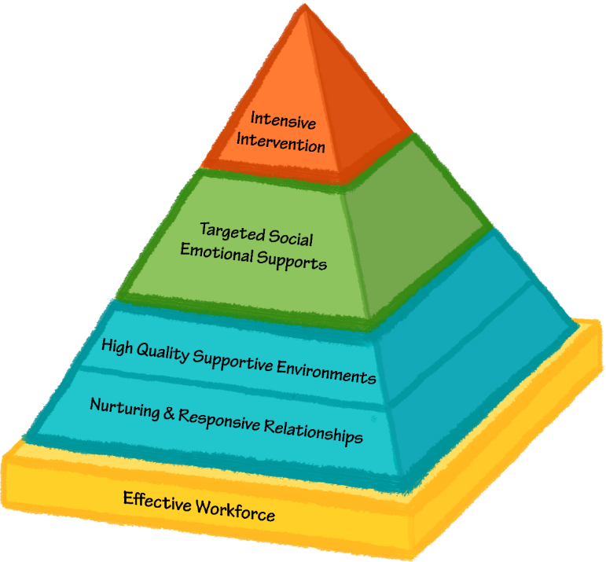
Pyramid Model for Promoting the Social Emotional Competence of Young Children
Tertiary Intervention Few
A Framework of Evidence-Based Practices
Secondary Prevention Some
Universal Promotion All

Slide 14

Pyramid Model Teachers
Connected, Confident, and Competent

Slide 15

Pyramid Model
Universal Promotion All

Slide 16
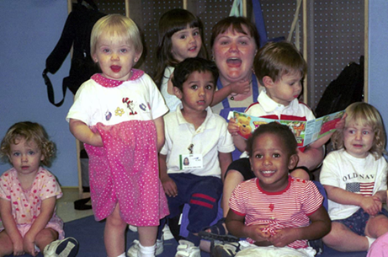
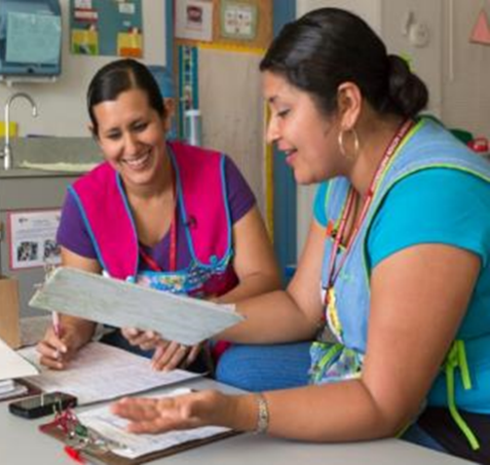
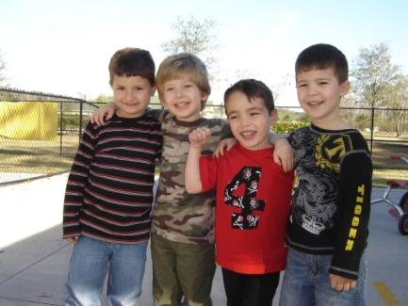
Nurturing and Responsive Relationships
Foundation of the Pyramid
Essential to healthy social development
Includes relationships with children, families and team members
Notes:
16
16
1m

Slide 17
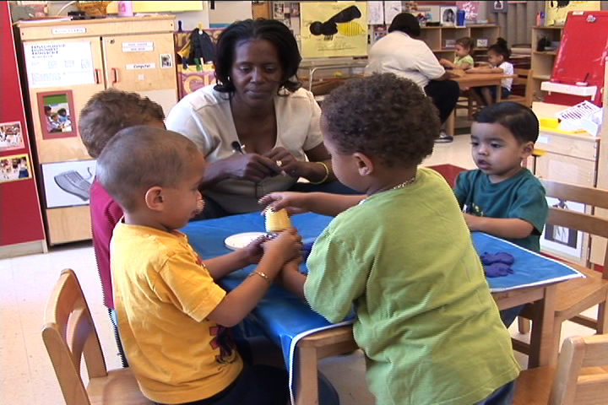
High Quality Environments
Inclusive early care and education environments
Comprehensive system of curriculum, assessment, and program evaluation
Environmental design, instructional materials, scheduling, child guidance, and teacher interactions that meet high quality practices as described by NAEYC and DEC
Notes:
17
17
17

Slide 18
Pyramid Model
Secondary Prevention Some
Universal Promotion All

Slide 19
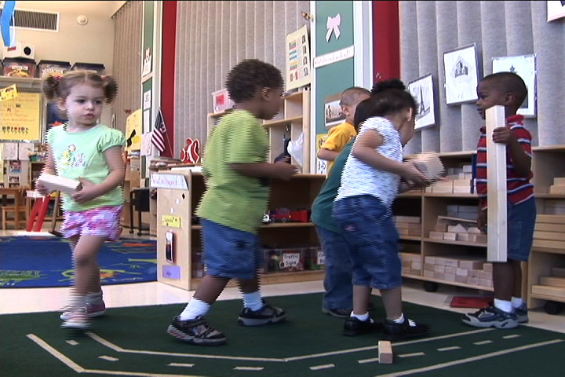
Targeted Social Emotional Supports
Self-regulation, expressing and understanding emotions, problem solving, developing social relationships as social emotional learning for ALL
Explicit instruction for Some
Increased opportunities for instruction, practice, feedback
Family partnerships
Progress monitoring and data decision-making
Notes:
19
19
19
The secondary or prevention level of the Pyramid includes the provision of explicit instruction in social skills and emotional regulation. In early childhood programs, all young children will require adult guidance and instruction to learn how to express their emotions appropriately, play cooperatively with peers, and use social problem solving strategies. However, for some children it will be necessary to provide systematic and focused instruction to teach children discrete social emotional skills. Children might need more focused instruction on skills such as: identifying and expressing emotions; self-regulation; social problem solving; initiating and maintaining interactions; cooperative responding; strategies for handling disappointment and anger; and friendship skills. Families in early intervention programs might need guidance and coaching from their early intervention provider for how to promote their child’s development of targeted social and emotional skills. Families of infants and young toddlers might need guidance and support for helping the very young child regulate emotions or stress and understand the emotions of others.

Slide 20
Pyramid Model
Tertiary Intervention Few
Secondary Prevention Some
Universal Promotion All

Slide 21
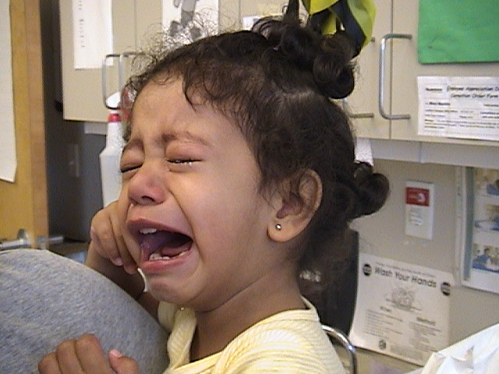
Individualized Intensive Interventions to Address Challenging Behavior
Comprehensive interventions across all settings including home and community
Assessment-based
Collaborative team
Skill-building
Notes:
21
21
When children have persistent challenging behavior that is not responsive to interventions at the previous levels, comprehensive interventions are developed to resolve problem behavior and support the development of new skills. At this level of the Pyramid Model, Positive Behavior Support (PBS) is used to develop and implement a plan of intensive, individualized intervention. PBS provides an approach to addressing problem behavior that is individually designed, can be applied within all natural environments by the child’s everyday caregivers, and is focused on supporting the child in developing new skills.

Slide 22
Process of Individualized Positive Behavior Support
Step 1: Establishing a collaborative team and identifying goals
Step 2: Gathering information (functional assessment)
Step 3: Developing hypotheses
Step 4: Designing behavior support plans
Step 5: Implementing, monitoring, evaluating outcomes, and refining plan in natural environments

Slide 23
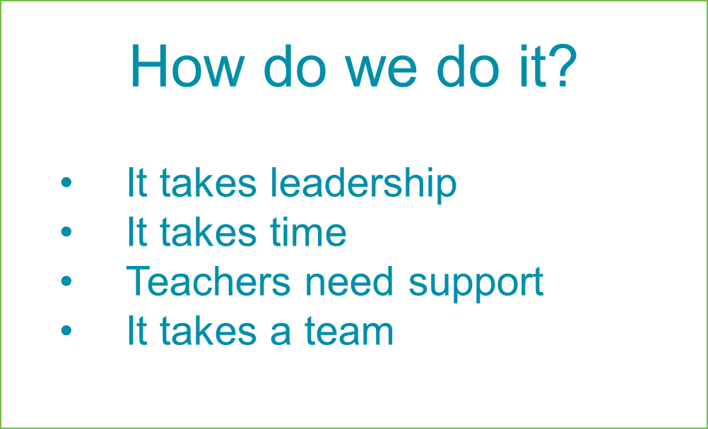

Program-Wide Implementation Guided by the Leadership Team
Leadership Team
Staff Buy-In
Program-Wide Expectations
Continuous Professional Development & Classroom Coaching
Family Engagement
Responding to Challenging Behavior
Data Decision-Making Examining Implementation and
Data Decision-Making Examining Implementation and Outcomes
Procedures for Responding to Challenging Behavior
Notes:
To do these practices with fidelity and to do them with a trauma-informed lens, it takes a leadership team. The leadership team ensures that the implementation supports are in place so that practitioners can implement these practices. This becomes particularly important when trying to support practitioners to become trauma-informed and to understand the support of children and families exposed to trauma. A professional who might join the leadership team and assist with building the implementation infrastructure to be trauma informed is the Early Childhood Mental Health Consultant.

Slide 24
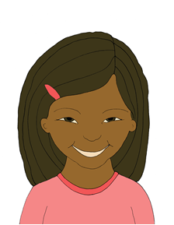
Outcomes for Children
Growth in social and emotional skills
Decreases in overall disruptive behavior in the classroom
Reduction in child challenging behavior
Increases in social interactions between children
Increases in child engagement in learning opportunities
Happy

Slide 25

Outcomes for Teachers and Staff
Shared language for communicating expectations
Improved capacity to teach social and emotional skills
Improved capacity to address challenging behavior
Ability to support families to promote social and emotional skills
Feeling supported by program in efforts to address challenging behavior
Positive relationships with families around issues related to challenging behavior
High fidelity programs report that No children are asked to leave due to behavior
Excited

Slide 26
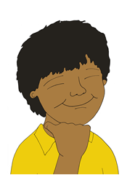
Outcomes for Families
Teaming between family and teachers for intervention strategies
Parents report feeling more supported in preventing and addressing challenging behavior
Decreases in parent concerns about safety and behavior
Proud

Slide 27

For More Information…
www.challengingbehavior.org

Slide 28
Poll
Our team really wants to commit to implementing Pyramid Model across our program.
But we want your input!
Please complete the survey at your table and leave in the box on your way out.

Slide 29
Sample Staff Buy-In Poll
Please take a moment to give us input on how you feel about program-wide adoption of Pyramid Model.
I feel confident about adopting the Pyramid Model. I support the need for a program-wide effort for:
Addressing children’s social competence and challenging behavior.
Using culturally responsive practices.
Addressing implicit bias.
I like the idea of program-wide adoption, but believe I need more training around this topic.
I like the idea of program-wide adoption, but do not feel I can make a commitment at this time.
I don’t feel like program-wide adoption will be beneficial and would rather not participate in the process.

